Slide 1
Pointers in C

Slide 2
Introduction to pointers
C is a very powerful language.
The Real power of C lies in pointers
The use of pointers make the code more efficient and compact.
Some of the uses of pointers are:
Simulating Call by reference
Returning more than one value from a function.
Accessing dynamically allocated memory
Implementing data structures like linked lists, trees and graphs
Improving efficiency

Slide 3
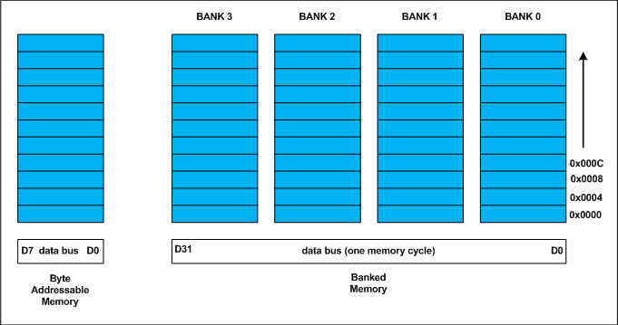
Memory Organization
Memory in a computer is made up of bytes arranged in a sequential manner
Each byte is identified by an index number, which is called the address of that byte.

Slide 4
Memory Organization
When a variable is declared, compiler reserves space for it.
The data type of the variable should also be mentioned so that the compiler knows how much space needs to be reserved.
For Eg: int age
The compiler reserves 4 consecutive bytes from memory for this variable and associates the name age with it.
Address |  | 2000 | 2001 | 2002 | 2003
Value

Slide 5
Address Operator
C Provides an address operator ‘&’ which returns the address of a variable when placed before it.
For Example: &age : address of variable age
& Salary : Address of variable salary

Slide 6
Program to print the address of variables using address operator
#include<stdio.h>
int main(void)
{
int age=30;
float salary=1500.50;
printf("Address of age=%p\n",&age);
printf("Address of salary=%p\n",&salary);
return 0;
}

Slide 7
Pointers
The address may be different each time you run your program, it depends on which part of memory is allocated by operating system for this program.
The format specifier %p is used to print the address.
The address operator cannot be used with constants, expressions or register variables.
&j ; – valid
&arr[i]; - valid
&289 – invalid
&(j+k) – invalid
&rvar – invalid if rvar is a register variable.

Slide 8
Pointer Variables
A pointer is a variable that stores memory address.
It is called pointer because it points to a particular location in memory by storing the address of that location.
Like other variables pointer variables has name, has to be declared and occupies some space in memory.

Slide 9
Declaration of a pointer Variable
Data_type *pname
pname: - is the name of a pointer variable, which should be a valid C identifier.
* - Preceding this name informs the compiler that the variable is a pointer.
Data_type : Base type of the pointer.
For eg: int *iptr;
Float *fptr;
Char *cptr;

Slide 10
Declaration of a pointer Variable
Pointers are variables so compiler will reserve space for them and they will have some address.
All pointers irrespective of their base type generally occupy same space in memory.

Slide 11
Assigning Address to a pointer variable
Global & Static pointers – automatically initialized to NULL;
Automatic pointer varible – Garbage value, pointing anywhere in memory
Int *iptr, age=30;
Double *dptr, x= 1500.89;
Iptr= &age;
Dptr= &x;

Slide 12
Assigning Address to a pointer variable
Int age=30, *iptr= &age;
Double x=150.78, *dptr= &x;

Slide 13
Dereferencing pointer variable
Dereferencing pointer variable is done using indirection operator - *
Dereferencing means accessing the variable whose address is stored in the pointer.
Int a= 87;
Float b=8.8;
Int *p1 = &a;
Float *p2=&b;

Slide 14
Dereferencing pointer variable
*p1=9; equivalent to a=9
(*p1)++; equivalent to a++;
X= *p2 +10; equivalent to x=b+10;
Printf(“%d %f”, *p1,*p2); equivalent to Printf(“%d %f”, a,b);
Scanf(“%d%f”,p1,p2); Printf(“%d %f”, &a, &b);
*(&age) - &age is an address, dereferencing it with * operator will give the variable at that address
*(&age) = age

Slide 15
Dereferencing pointer variable
While declaring a pointer variable, we have to mention the datatype.
When we use indirection operator, the number of bytes retrieved will be different for different data types.

Slide 16
Dereferencing pointer variables
#include<stdio.h>
int main(void)
{
int a=87;
float b=4.5;
int *p1=&a;
float *p2=&b;
printf("Value of p1 = Address of a = %p\n",p1);
printf("Value of p2 = Address of b = %p\n",p2);
printf("Address of p1 = %p\n",&p1);
printf("Address of p2 = %p\n",&p2);
printf("Value of a = %d %d %d\n",a,*p1,*(&a));
printf("Value of b = %.1f %.1f %.1f\n",b,*p2,*(&b));
return 0;
}

Slide 17
Program to print size of pointer variables and size of values dereferenced by them
#include<stdio.h>
int main(void)
{
char a='x',*p1=&a;
int b=12,*p2=&b;
float c=12.4,*p3=&c;
double d=18.34,*p4=&d;
printf("sizeof(p1)=%u, sizeof(*p1)=%u\n",sizeof(p1),sizeof(*p1));
printf("sizeof(p2)=%u, sizeof(*p2)=%u\n",sizeof(p2),sizeof(*p2));
printf("sizeof(p3)=%u, sizeof(*p3)=%u\n",sizeof(p3),sizeof(*p3));
printf("sizeof(p4)=%u, sizeof(*p4)=%u\n",sizeof(p4),sizeof(*p4));
return 0;
}

Slide 18
Pointer Arithmetic
All Arithmetic operations are not possible
The only valid operations that can be performed are:
Addition of an integer to a pointer and increment operation.
Subtraction of an integer to a pointer and Decrement operation.
Subtraction of a pointer from another pointer of same type.

Slide 19
Pointer arithmetic
#include<stdio.h>
int main(void)
{
int a=5,*pi=&a;
char b='x',*pc=&b;
float c=5.5,*pf=&c;
printf("Value of pi=Address of a=%p\n",pi);
printf("Value of pc=Address of b=%p\n",pc);
printf("Value of pf=Address of c=%p\n",pf);
pi++;// pi+4 bytes
pc++;// pc + 1 byte
pf++;// pf + 4 bytes
printf("Now value of pi=%p\n",pi);
printf("Now value of pc=%p\n",pc);
printf("Now value of pf=%p\n",pf);
return 0;
}

Slide 20
Postfix/prefix increment/decrement in a pointer variable of base type int
#include<stdio.h>
int main(void)
{
int a=5;
int *p;
p = &a; // p=1000
printf("Value of p = Address of a = %p\n",p);// 1000
printf("Value of p = %p\n",++p); // 1004
printf("Value of p = %p\n",p++); // 1004 vi tang trong lan sau
printf("Value of p = %p\n",p); // 1008
printf("Value of p = %p\n",--p); // 1004
printf("Value of p = %p\n",p--); //1004
printf("Value of p = %p\n",p); // 1000
return 0;
}

Slide 21
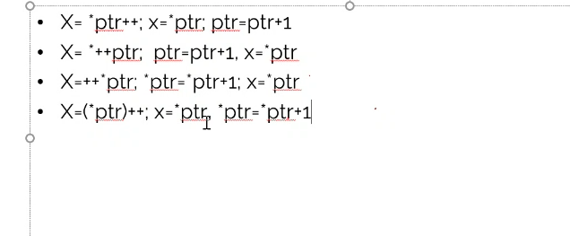
Precedence of dereferencing operator and increment and decrement operators
X= *ptr++;
X= *++ptr;
X=++*ptr;
X=(*ptr)++;

Slide 22
Pointer to pointer
Data_type **pptr;
Int a=5;
Int *pa=&a;
Int *ppa=&pa; // the same int ** ppa

Slide 23
Pointer to pointer
#include<stdio.h>
int main(void)
{
int a=5;
int *pa;
int **ppa;
pa = &a;
ppa = &pa;
printf("Address of a=%p\n",&a);
printf("Value of pa=Address of a=%p\n",pa);
printf("Value of *pa=Value of a=%d\n",*pa); //5
printf(“Address of pa=%p\n”,&pa);
printf("Value of ppa=Address of pa=%p\n",ppa);// store address of pa
printf("Value of *ppa=Value of pa=%p\n",*ppa); // store value of Pa
printf("Value of **ppa=Value of a=%d\n",**ppa);//5
printf("Address of ppa=%p\n",&ppa);
return 0;
}

Slide 24
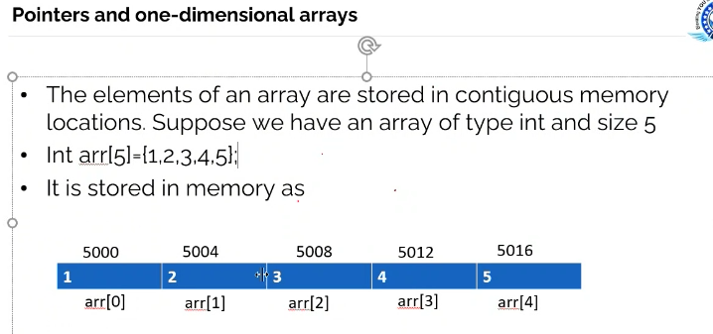

Slide 25
Pointers and one-dimensional arrays
#include<stdio.h>
int main(void)
{
int arr[5] = {5,10,15,20,25};
int i;
for(i=0; i<5; i++)
{
printf("Value of arr[%d] = %d\t",i,arr[i]);// the same *(arr+i)
printf("Address of arr[%d] = %p\n",i,&arr[i]);
}
return 0;
}

Slide 26
Program to print the value and address of elements of an array using pointer notation
#include<stdio.h>
int main(void)
{
int arr[5]={5,10,15,20,25};
int i;
for(i=0; i<5; i++)
{
printf("Value of arr[%d] = %d\t",i,*(arr+i));
printf("Address of arr[%d] = %p\n",i,arr+i);
}
return 0;
}

Slide 27
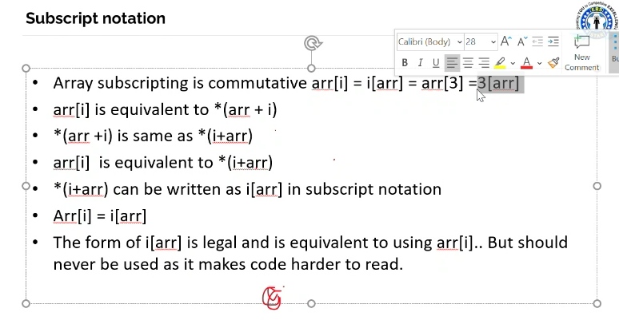

Slide 28
Program to print the value of array elements using pointer and subscript notation
#include<stdio.h>
int main(void)
{
int arr[5] = {5,10,15,20,25};
int i=0;
for(i=0; i<5; i++)
{
printf("Value of arr[%d] = ",i);
printf("%d\t",arr[i]);
printf("%d\t",*(arr+i));
printf("%d\t",*(i+arr));
printf("%d\n",i[arr]);
printf("Address of arr[%d] = %p\n",i,&arr[i]);
}
return 0;
}

Slide 29
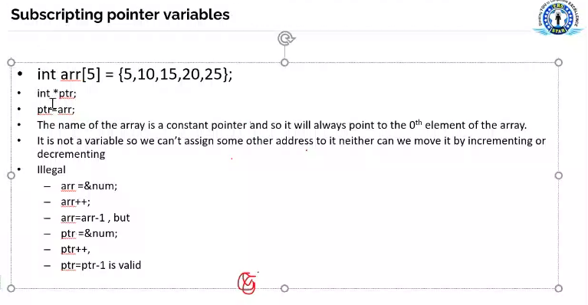

Slide 30
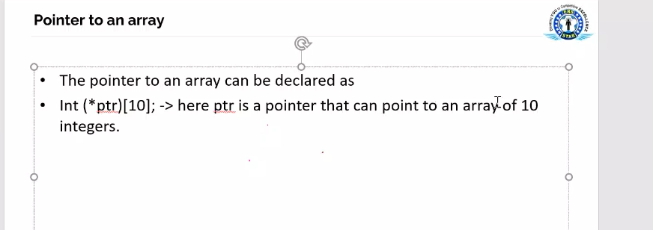

Slide 31
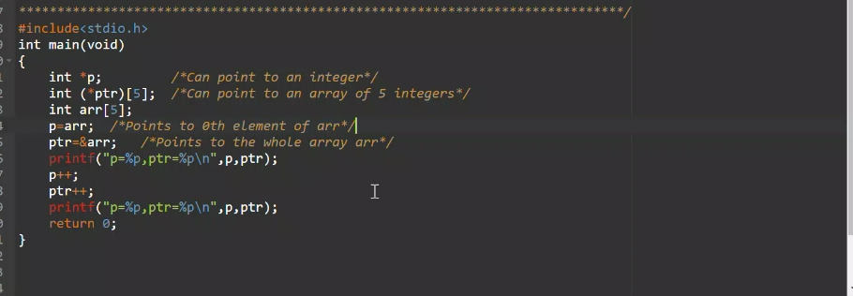

Slide 32
Program to dereference a pointer to an array
#include<stdio.h>
int main(void)
{
int arr[5] = {3,5,6,7,9};
int *p=arr;
int (*ptr)[5]=&arr;
printf("p=%p, ptr=%p\n",p,ptr);
printf("*p=%d, *ptr=%p\n",*p,*ptr);
printf("sizeof(p)=%u,sizeof(*p)=%u\n",sizeof(p),sizeof(*p));
printf("sizeof(ptr)=%u,sizeof(*ptr)=%u\n",sizeof(ptr),sizeof(*ptr));
return 0;
}

Slide 33
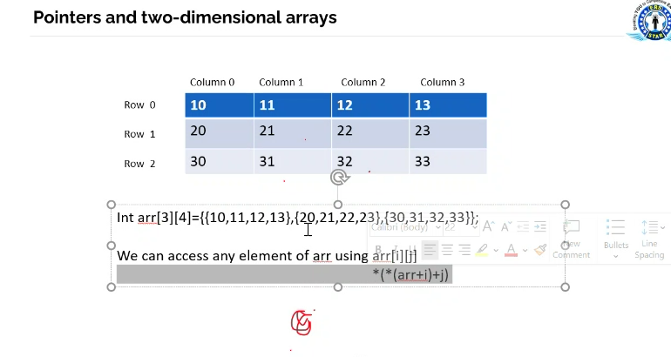

Slide 34
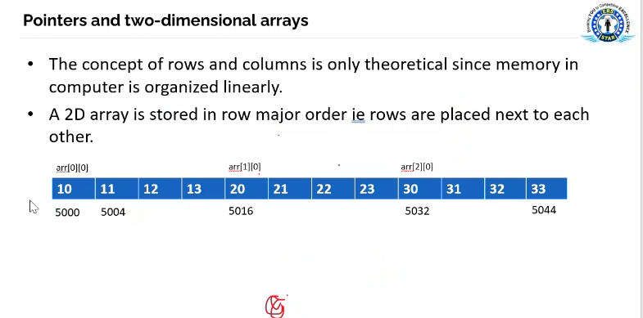

Slide 35
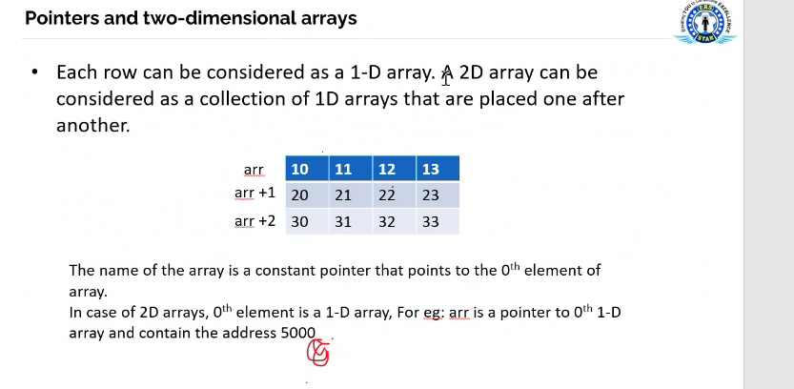

Slide 36
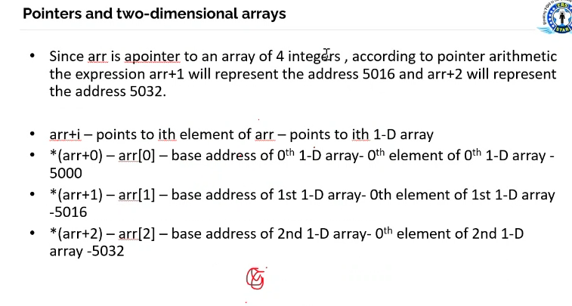

Slide 37
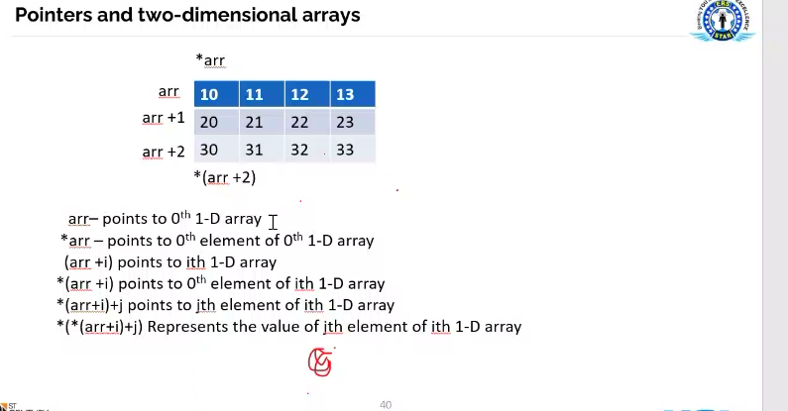

Slide 38
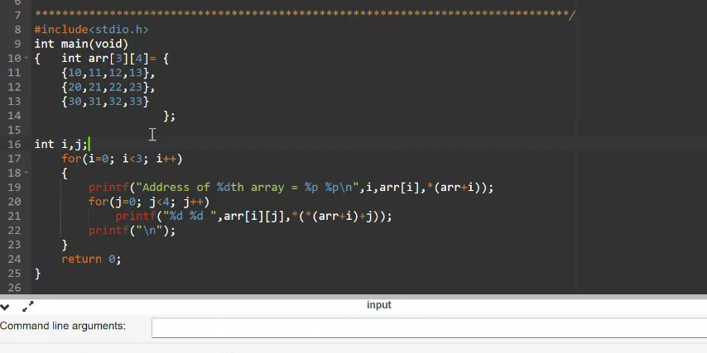

Slide 39
Pointers and Functions
Arguments can be passed to function in two ways:
Call by value
Call by reference

Slide 40
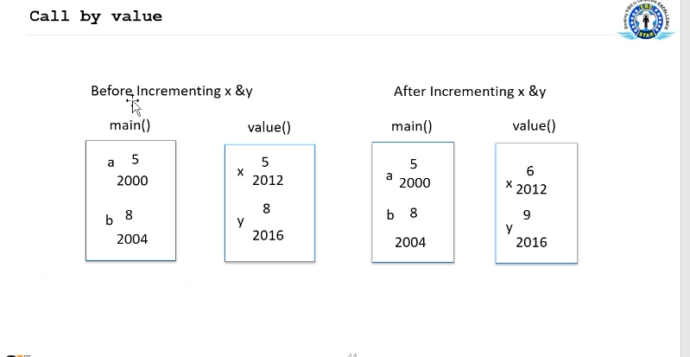

Slide 41
Call by value
#include<stdio.h>
void value(int x,int y);
int main(void)
{
int a=5,b=8;
printf("a=%d,b=%d\n",a,b);
value(a,b);
printf("a=%d,b=%d\n",a,b);
return 0;
}
void value(int x,int y)
{
x++;
y++;
printf("x=%d,y=%d\n",x,y);
}

Slide 42
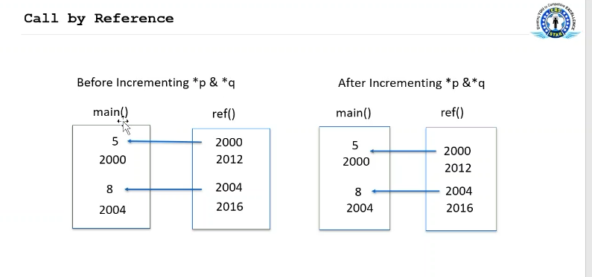

Slide 43
Program to explain call by reference
#include<stdio.h>
void ref(int *p,int *q);
int main(void)
{
int a=5,b=8;
printf("a=%d,b=%d\n",a,b);
ref(&a,&b);
printf("a=%d,b=%d\n",a,b);
return 0;
}
void ref(int *p,int *q)
{
(*p)++;
(*q)++;
printf("*p=%d, *q=%d\n",*p,*q);
}

Slide 44
Returning more than one value from a function using call by reference
#include<stdio.h>
void func(int x,int y,int *ps,int *pd,int *pp);
int main(void)
{
int a,b,sum,diff,prod;
a=6;
b=4;
func(a,b,&sum,&diff,&prod);
printf("Sum=%d, Difference=%d, Product=%d\n",sum,diff,prod);
return 0;
}
// function nay co the tra ve 3 gia tri ps, pd , ps ma 1 func bthg k the tra ve
void func(int x,int y,int *ps,int *pd,int *pp)
{
*ps=x+y;
*pd=x-y;
*pp=x*y;
}

Slide 45
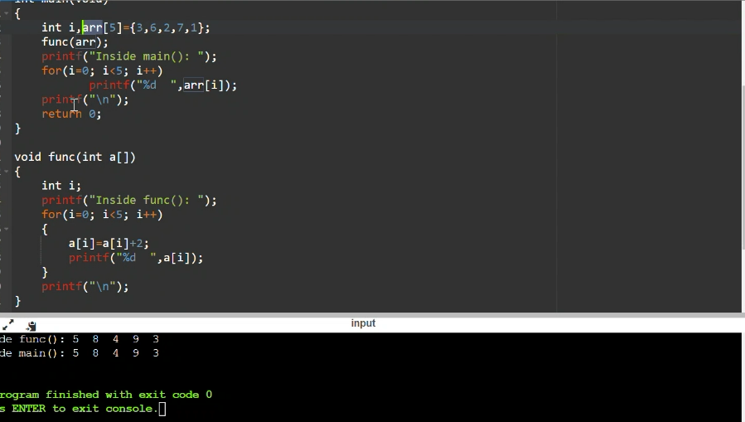

Slide 46
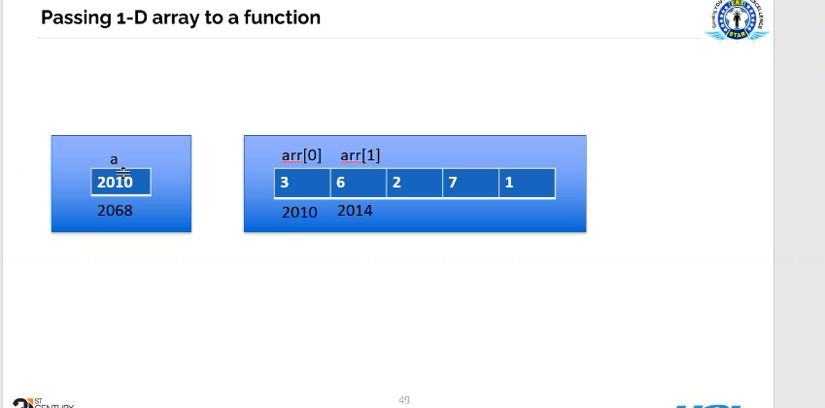

Slide 47
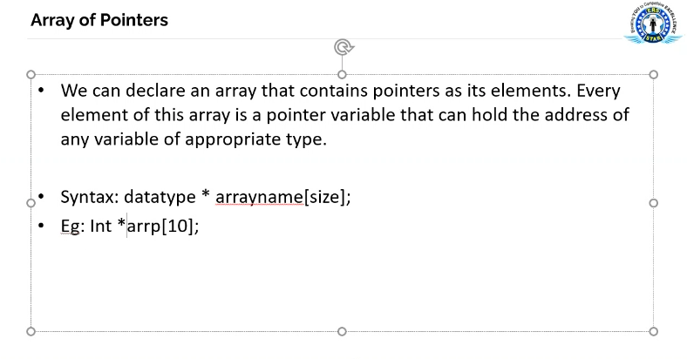

Slide 48
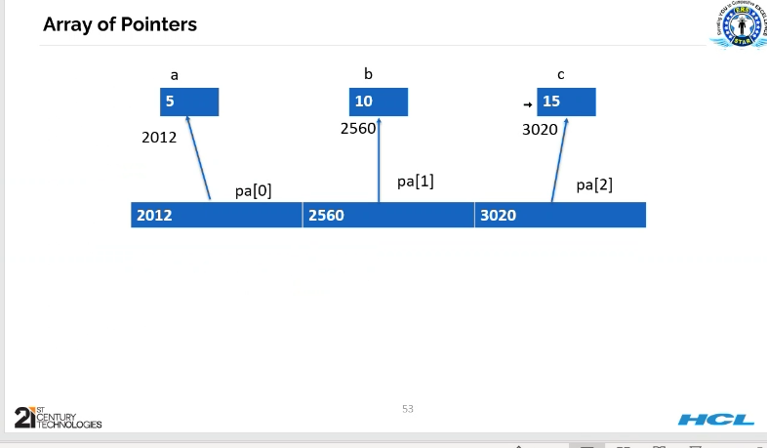

Slide 49
Array of Pointers
#include<stdio.h>
int main(void)
{
int *pa[3];// each element is a pointer, it can hold address
int i,a=5,b=10,c=15;
pa[0]=&a; pa[1]=&b; pa[2]=&c;
for(i=0; i<3; i++)
{
printf(“pa[%d]=%p\t”,i,pa[i]);
printf("*pa[%d]=%d\n",i,*pa[i]);
}
return 0;
}

Slide 50
Void Pointers
Void *vpt;
Int i=2, *ip=&I;
Float f=2.3,*fp=&f;
Double d;
Void *vp;
Ip=fp; - incorrect
Vp=ip;
Vp=fp;
Vp=&d;

Slide 51
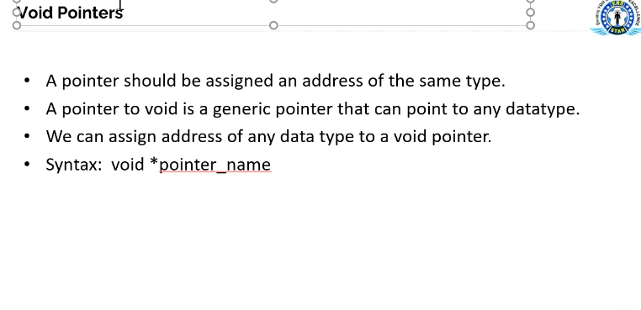

Slide 52
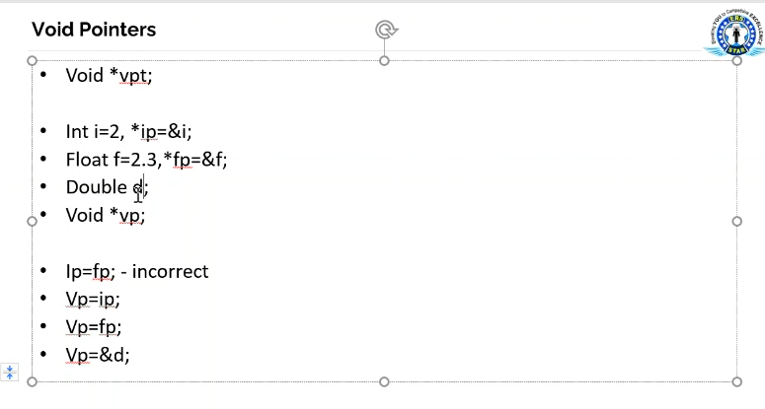

Slide 53
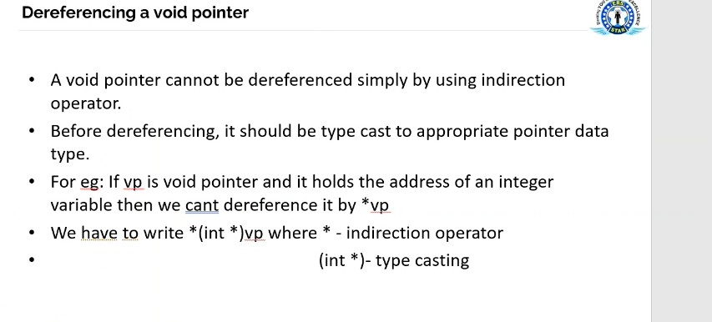

Slide 54
Dereferencing a void pointer
#include<stdio.h>
int main(void)
{
int a=3;
float b=3.4,*fp=&b;
void *vp;
vp=&a;
printf("Value of a = %d\n",*(int *)vp);// 3
*(int *)vp = 12;
printf("Value of a = %d\n",*(int *)vp);//12
vp=fp;
printf("Value of b = %f\n",*(float *)vp);//3.4000
return 0;
}

Slide 55
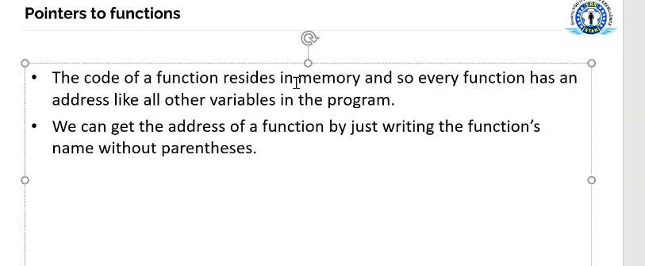

Slide 56
Pointers to functions- Program to illustrate that every function has an address and how to access that address
#include<stdio.h>
void func1();
int main(void)
{
printf("Address of function main() is : %p\n",main);
printf("Address of function func1() is : %p\n",func1);
return 0;
}
void func1()
{
printf("C in depth\n");
}

Slide 57
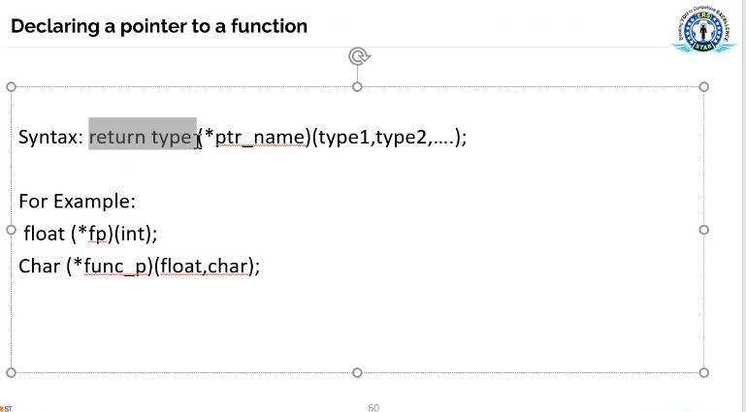

Slide 58
Program to invoke a function using function pointer
#include<stdio.h>
float add(int,float),result;
int main(void)
{
float (*fp)(int,float);// con tro function➔ tro toi ham mong muon
float result;
fp=add; /*Assign address of function add() to pointer fp add la dia chi cua ham add*/
/*Invoking a function directly using function’s name */
result = add(5,6.6);
printf("%f\n",result);
/*Invoking a function indirectly by dereferencing function pointer */
result = (*fp)(5,6.6);
printf("%f\n",result);
return 0;
}
float add(int a,float b)
{
return a+b;
}

Slide 59
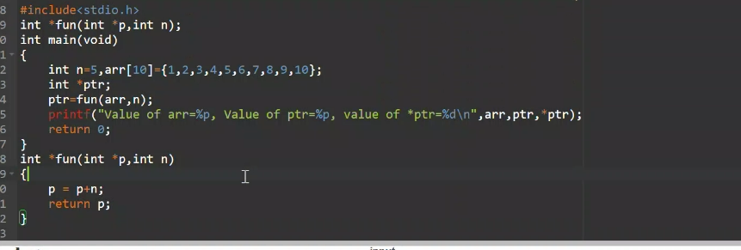

Slide 60
Program to send a function's address as an argument to other function
#include<stdio.h>
void func(char,void(*fp)(float));
void fun1(float);
int main(void)
{
printf("Function main() called\n");
func('a',fun1);
return 0;
}
void func(char b,void(*fp)(float))
{
printf("Function func() called\n");
(*fp)(8.5);
}
void fun1(float f)
{
printf("Function fun1() called\n");
}

Slide 61
Array of Function Pointers
#include<stdio.h>
float add(float,int);
float sub(float,int);
float mul(float,int);
float div(float,int);
int main(void)
{
int i,b;
float a;
float(*fp[])(float,int)={add,sub,mul,div};
char *operation[]={"Add","Subtract","Multiply","Divide"};
printf("Enter a float and a integer : " );
scanf("%f%d",&a,&b);
for(i=0;i<4;i++)
printf("%s: %f\n",operation[i],(*fp[i])(a,b));
return 0;
}
float add(float a,int b)
{
return a+b;
}
float sub(float a,int b)
{
return a-b;
}
float mul(float a,int b)
{
return a*b;
}
float div(float a,int b)
{
return a/b;
}

Slide 62
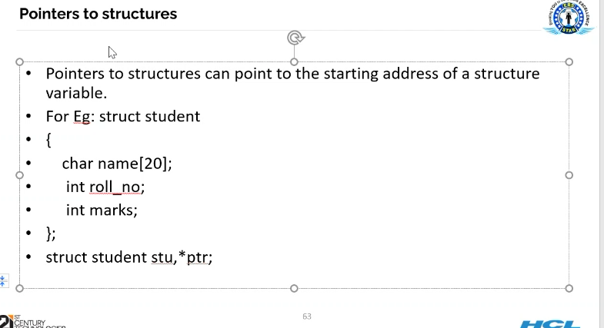

Slide 63
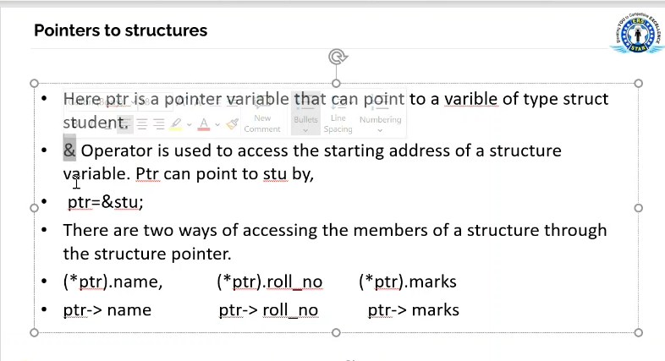

Slide 64
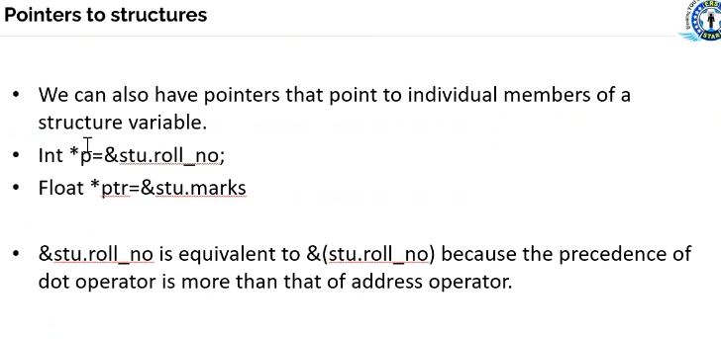

Slide 65
Program to understand pointers to structures
#include<stdio.h>
struct student
{
char name[20];
int rollno;
int marks;
};
int main(void)
{
struct student stu = {"Mary", 25, 68};
struct student *ptr = &stu;
printf("Name - %s\t", ptr->name);
printf("Rollno - %d\t", ptr->rollno);
printf("Marks - %d\n", ptr->marks);
return 0;
}

Slide 66
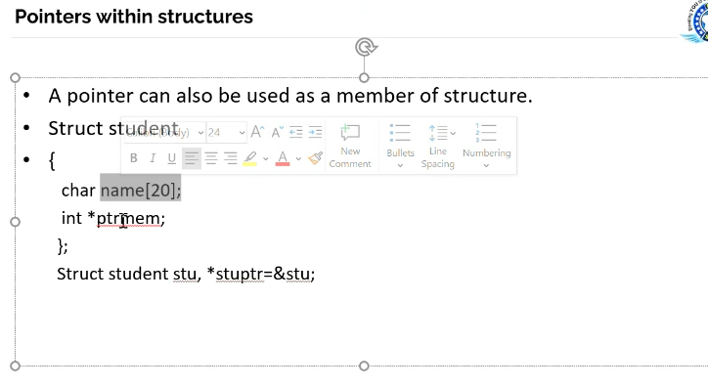

Slide 67
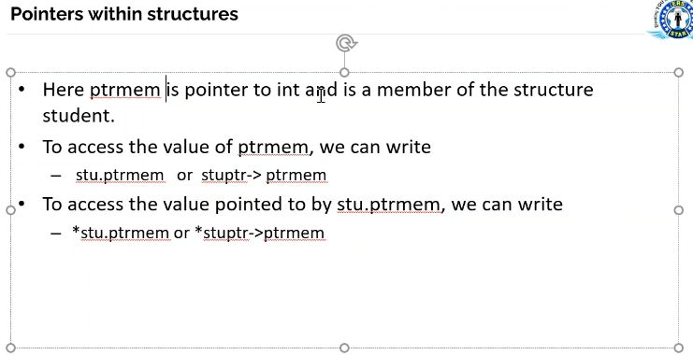

Slide 68
Program to understand how structure members are sent to a function
#include<stdio.h>
#include<string.h>
struct student
{
char name[20];
int rollno;
int marks;
};
void display(char name[],int rollno,int marks);
int main(void)
{
struct student stu1={"John",12,87};
struct student stu2;
strcpy(stu2.name,"Mary");
stu2.rollno=18;
stu2.marks=90;
display(stu1.name,stu1.rollno,stu1.marks);
display(stu2.name,stu2.rollno,stu2.marks);
return 0;
}
void display(char name[],int rollno,int marks)
{
printf("Name - %s\t",name);
printf("Rollno - %d\t",rollno);
printf("Marks - %d\n",marks);
}

Slide 69
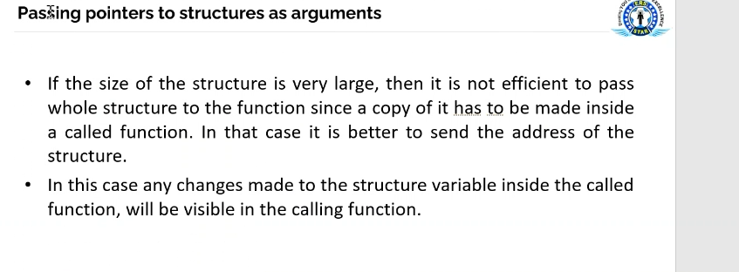

Slide 70
Program to understand how a structure variable is sent to a function
#include<stdio.h>
struct student
{
char name[20];
int rollno;
int marks;
};
void display(struct student);
int main(void)
{
struct student stu1={"John",12,87};
struct student stu2={"Mary",18,90};
display(stu1);
display(stu2);
return 0;
}
void display(struct student stu)
{
printf("Name - %s\t",stu.name);
printf("Rollno - %d\t",stu.rollno);
printf("Marks - %d\n",stu.marks);
}

Slide 71
Program to understand how a pointer to structure variable is sent to a function
#include<stdio.h>
struct student
{
char name[20];
int rollno;
int marks;
};
void display(struct student *);
void inc_marks(struct student *);
int main(void)
{
struct student stu1 = {"John",12,87};
struct student stu2 = {"Mary",18,90};
inc_marks(&stu1);
inc_marks(&stu2);
display(&stu1);
display(&stu2);
return 0;
}
void inc_marks(struct student *stuptr)
{
(stuptr->marks)++;
}
void display(struct student *stuptr)
{
printf("Name - %s\t",stuptr->name);
printf("Rollno - %d\t",stuptr->rollno);
printf("Marks - %d\n",stuptr->marks);
}

Slide 72
Program to understand how a structure variable is returned from a function
#include<stdio.h>
struct student
{
char name[20];
int rollno;
int marks;
};
void display(struct student);
struct student change(struct student stu);
int main(void)
{
struct student stu1 = {"John",12,87};
struct student stu2 = {"Mary",18,90};
stu1 = change(stu1);
stu2 = change(stu2);
display(stu1);
display(stu2);
return 0;
}
struct student change(struct student stu)
{
stu.marks=stu.marks + 5;
stu.rollno=stu.rollno-10;
return stu;
}
void display(struct student stu)
{
printf("Name - %s\t", stu.name);
printf("Rollno - %d\t", stu.rollno);
printf("Marks - %d\n", stu.marks);
}

Slide 73
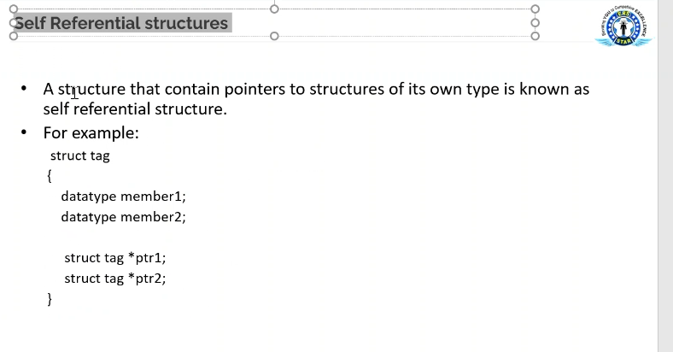

Slide 74
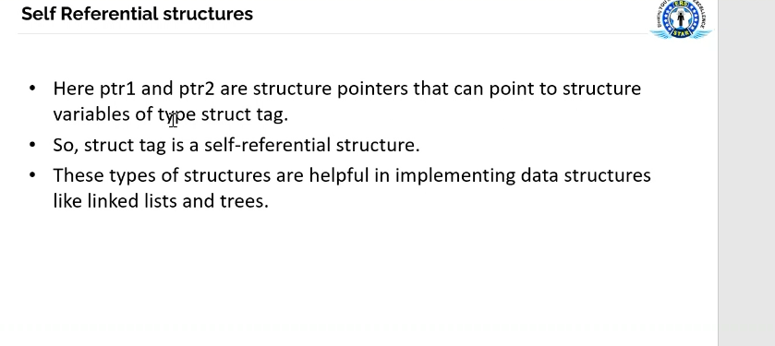

Slide 75
Program to understand how a pointer to structure is returned from a function
#include<stdio.h>
#include<string.h>
struct student
{
char name[20];
int rollno;
int marks;
};
void display(struct student *);
struct student *func(struct student *p1, struct student *p2);
int main(void)
{
struct student *stuptr;
struct student stu1={"Dev",23,78}, stu2={"Ved",12,89};
stuptr = func(&stu1, &stu2);
display(stuptr);
return 0;
}
struct student *func(struct student *p1, struct student *p2)
{
if(p1->marks > p2->marks)
return p1;
else
return p2;
}
void display( struct student *stuptr)
{
printf("Name - %s\t", stuptr->name);
printf("Rollno - %d\t", stuptr->rollno);
printf("Marks - %d\n", stuptr->marks);
}

Slide 76
Program to understand how an array of structures is sent to a function
#include<stdio.h>
struct student
{
char name[20];
int rollno;
int marks;
};
void display(struct student);
void dec_marks(struct student stuarr[]);
int main(void)
{
int i;
struct student stuarr[3]={
{"Mary",12,98},
{"John",11,97},
{"Tom",13,89}
};
dec_marks(stuarr);
for(i=0; i<3; i++)
display(stuarr[i]);
return 0;
}
void dec_marks(struct student stuarr[])
{
int i;
for(i=0; i<3; i++)
stuarr[i].marks = stuarr[i].marks-10;
}
void display(struct student stu)
{
printf("Name - %s\t", stu.name);
printf("Rollno - %d\t", stu.rollno);
printf("Marks - %d\n", stu.marks);
}

Slide 77
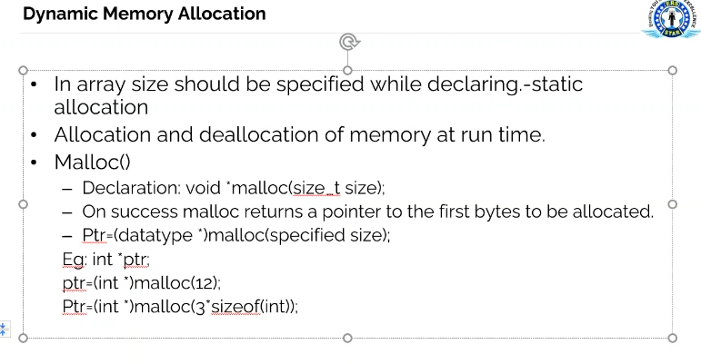

Slide 78
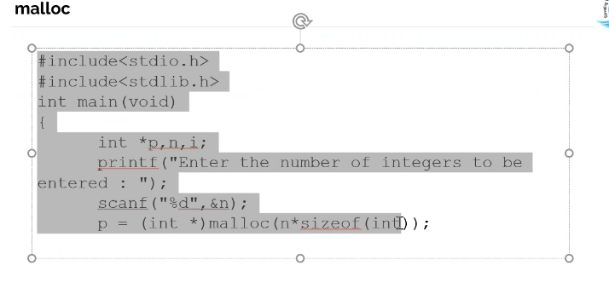

Slide 79
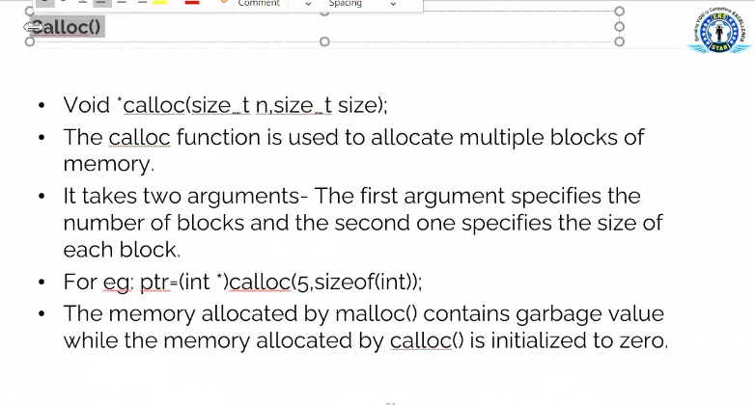

Slide 80
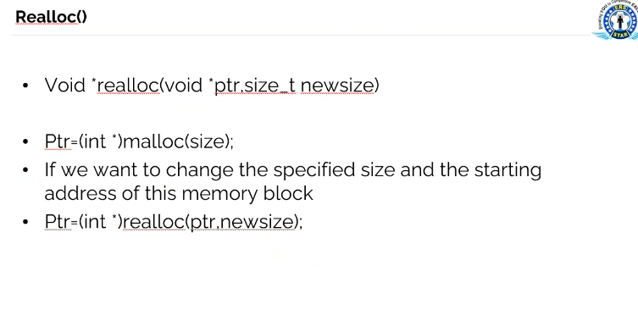

Slide 81
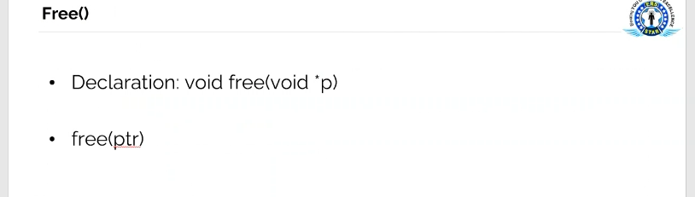

Slide 82
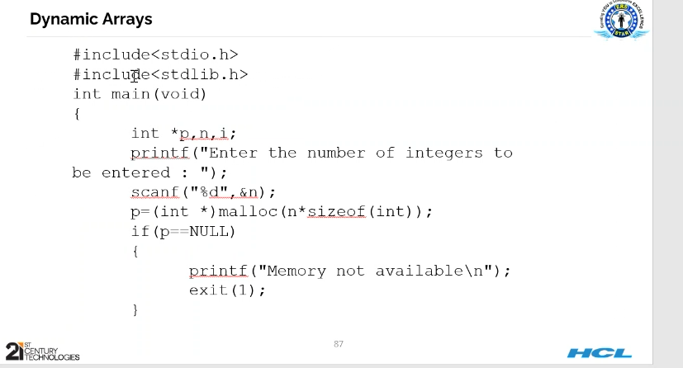

Slide 83
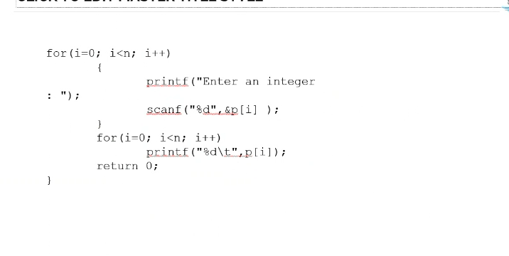

Slide 84
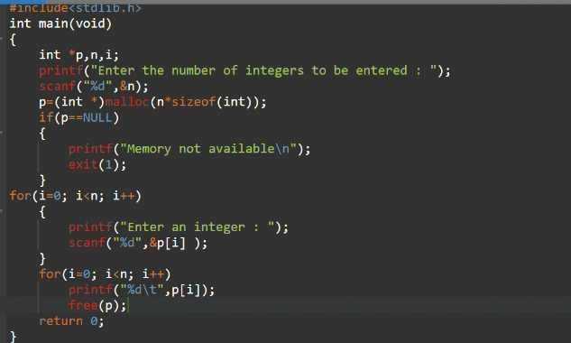

Slide 86
Thank You
Notes:
Thank You.

